Slide 1







BRAINSTORM
Software
Engineering
SESSION

Slide 2




Design and Implementation
1
Software design and implementation are crucial stages in the software engineering process.
Design involves identifying software components and their relationships based on requirements.
Implementation is the process of turning the design into a working program.
Building off-the-shelf systems (COTS) can be cheaper and faster than developing from scratch.
2
3
4

Slide 3
Object-Oriented Design using the UML
1
Structured object-oriented design processes involve developing various system models.
These models can be beneficial for large systems but may be too complex for small ones.
Common activities include defining context, designing architecture, identifying objects, and specifying interfaces.
An example process is illustrated using a wilderness weather station design.
2
3
4

Slide 4
System Context and Interactions
1
Understanding the system's environment is crucial for functionality and structure.
System context models show other systems in the environment.
Interaction models show how the system interacts with its environment during use.
Establishing boundaries helps define what features belong in the system and which belong elsewhere.
2
3
4

Slide 5



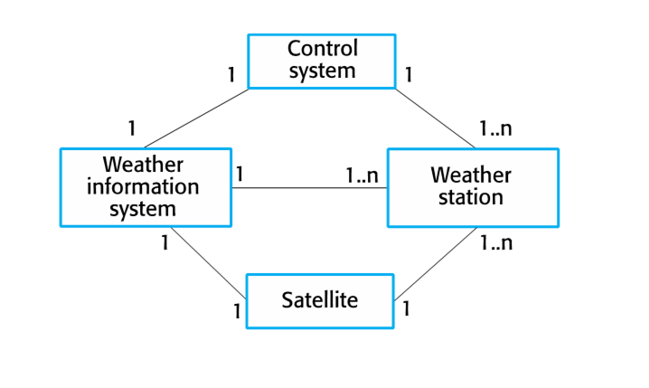

System Context for the Weather Station
1
• The weather station interacts with sensors, a data logger, and a user interface.
2
• It receives data from sensors, stores it in the logger, and displays it on the interface.
3
• Understanding these interactions helps define the system's functionality and structure.

Slide 6
Context and interaction models
1
Contexte model
2
interaction model
Simple Block Diagram
Use case

Slide 7
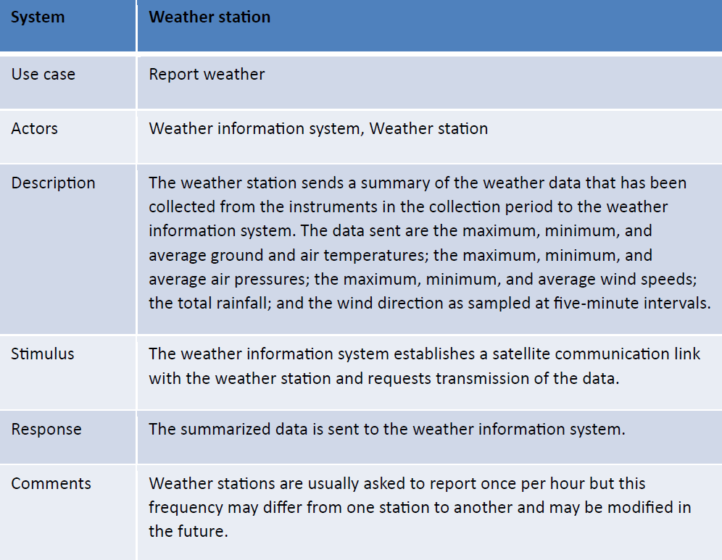
Use case description—Report weather

Slide 8
Architectural Design
Basic components of the system
High-level architecture of weather station

Slide 9

Object class identification
what is the object that makes up the system?
approaches to identification
Grammer
The tangible thing
1
Noun => Object
Attribute and Verbs => Operations and Services
2
Organization , location , Rule

Slide 10
Design Model :
Design model show object and object classes and relation between them
Structural model : it’s the static part of the model like objects and objects classes
Dynamic model : it’s the dynamic part of interaction between objects

Slide 11


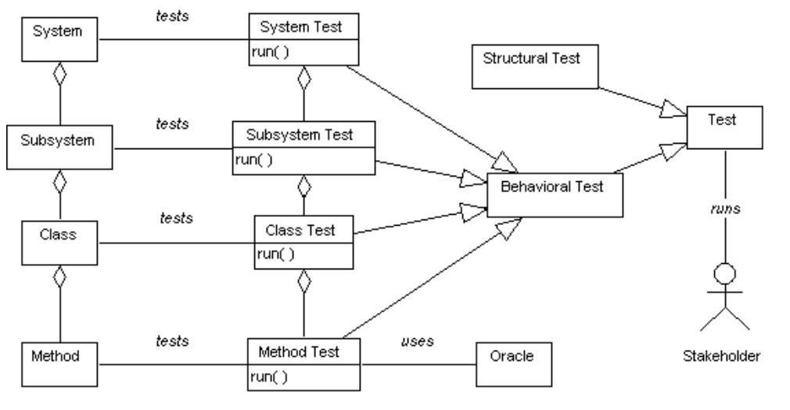
Examples:
Subsystem model
Example of Subsystem model
Is a model which is used to do a certain task and is not part of the main system and it’s object are logically related and when grouped called package

Slide 12
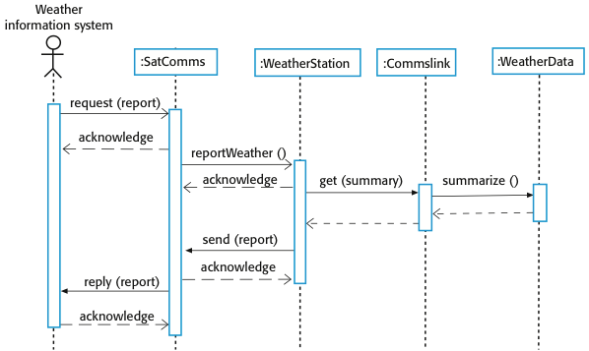
Examples:
Sequence model
Sequence diagram describing data collection
It arranges the sequence of events inside the system and their interaction

Slide 13
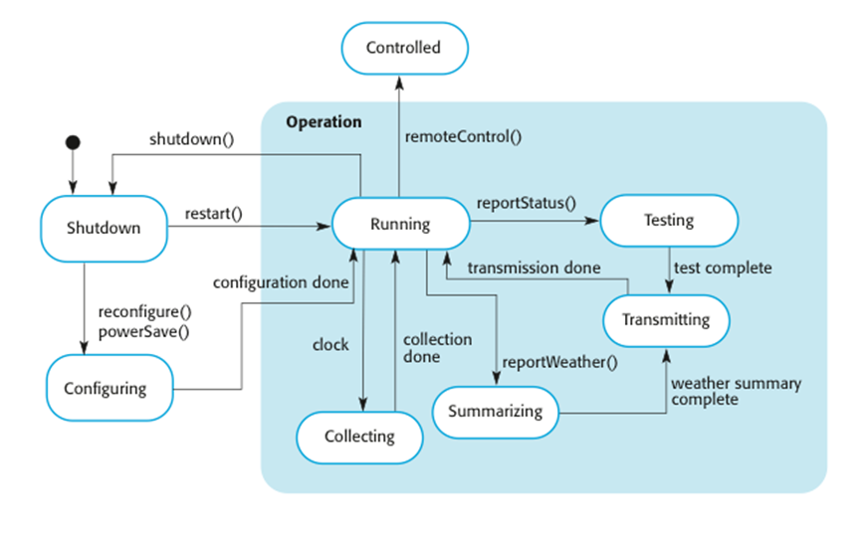
Examples:
State model
Sequence diagram describing data collection
It determines the interaction between the objects and the system and the outer world and the system
And it shows how the object will respond to different services-

Slide 14


Interface specification :
Weather station interfaces
¡Idea genial!
Awesome idea!
It needs to be done so the objects can be designed in parallel
Designers should avoid designing interface representation but should hide it in object it self

Slide 15

Design pattern :
Pattern design
Name
Problem description
Solution description
Consequences
Is a way of reusing knowledge of a problem and its solution
And it can be used in different settings
It uses OOP characteristics as inheritance polymorphism
Observer pattern
Name
Description.
Problem description
Solution description
Consequences

Slide 16

Design problems:
To use patterns you need to recognise that any design problem you face may have an associated pattern that can apply
Iterator pattern
Observer pattern
provide a standard way to access collections
tell several objects that the state of other objects have changed
Observer pattern
allow the possibility of extending the functionanlity of an existing class at run time

Slide 17


Implementation issues
Reuse levels
1
Reuse
1
The abstraction level
2
Configuration management
2
The object level
3
Host target development
3
The component level
4
The system level

Slide 18
Reuse costs
1
The costs of the time spent in looking for a software
the costs of buying the reusable software
The costs of adapting and configuration the reusable software components
The costs of integration resuable software elements with each other and with the new code
2
3
4
Configuration management
Is the name given to general process of managing a changing software systemUsed to support the system integration process

Slide 19
Configuration management activities
1
Version management
where support is provided to keep track of the different versions of software components.
System integration
where support is provided to help developers define what versions of components are used to create each version of a system.
Problem tracking
where support is provided to allow users to report bugs and other problems
2
SESSION
3

Slide 20
Host-target development
Most software is developed on one computer (the host), but runs on a separate machine (the target).
Development platform tools
1
An integrated compiler and syntax-directed editing system that allows you to create, edit and compile code.
Graphical editing tools, such as tools to edit UML models.
Testing tools, such as Junit that can automatically run a set of tests on a new version of a program.
Project support tools that help you organize the code for different development projects.
2
3
4

Slide 21
Integrated development environments (IDEs)
An IDE is a set of software tools that supports different aspects of software development, within some common framework and user interface.
Component/system deployment factors
1
component is designed for a specific hardware architecture.
High availability systems may require components to be deployed on more than one platform.
If there is a high level of communications traffic between components, it usually makes sense to deploy them on the same platform or on platforms that are physically close to one other.
2
3

Slide 22

Open source development
Open source business
Open source development Is an aproach to software development in which the source code of a software system in published and volunteers are invited to participate in the development process and its roots are in the free software foundation (www.fsf.org)
Examples of open source systems :
Now more companies using an open source ,They believe that involving the open source community will allow software to be developed more cheaply and more quickly and will create a community of software users
Open source licensing
1
1
Linux
Java
The web server Apache
license models
license management
2
2
3

Slide 23

Belall Omar
Abdullah Mohamed Abbas
Omar Hikal
Ali Arabi Amr Ahmed
Abdo Mahmoud
Youssef Khalil
Mohamed Ali
Fahmy Eid Fady Yasser

Slide 24

THANK
YOU

